Slide 1
9.3.4 Siegel’s Exchange Rate Paradox 9.3.5 Forward Exchange Rates
報告人: 汪文豪
報告日期: 2023.06.06

Slide 2
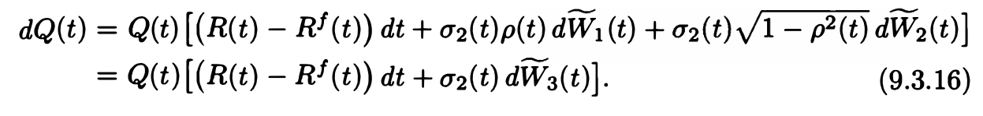
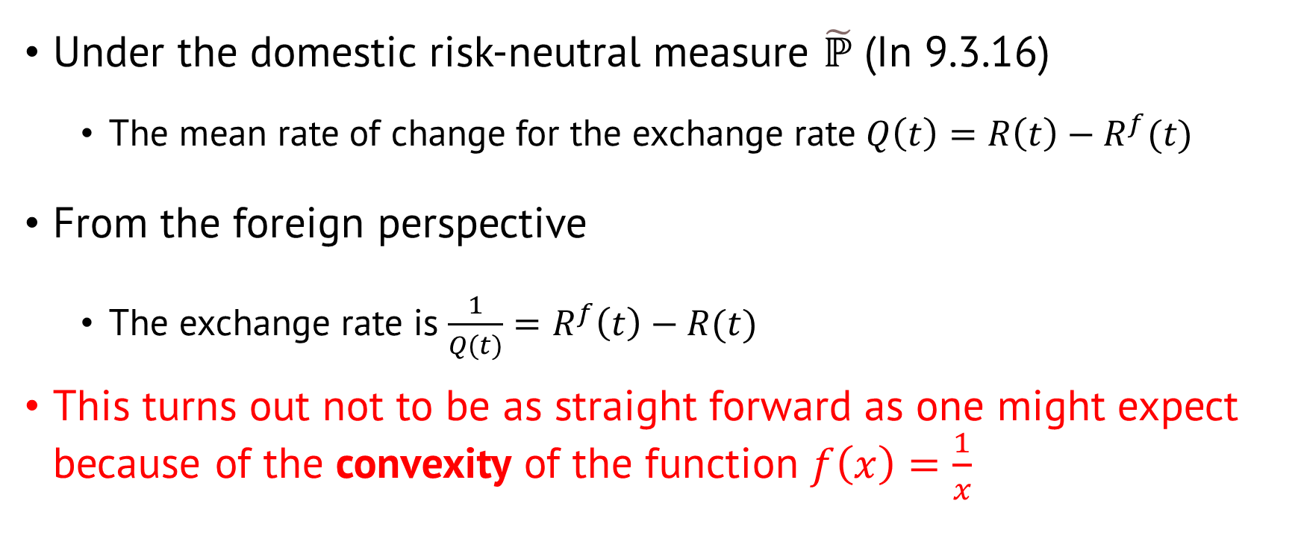
9.3.4 Siegel’s Exchange Rate Paradox
Under the domestic risk-neutral measure $\tilde{ℙ}$ (In 9.3.16)
The mean rate of change for the exchange rate $Q\left(t\right)=R\left(t\right)−R^{f}(t)$
From the foreign perspective
The exchange rate is $\frac{1}{Q(t)}=R^{f}\left(t\right)−R(t)$
This turns out not to be as straight forward as one might expect because of the convexity of the function $f\left(x\right)=\frac{1}{x}$
Notes:
Q(t) 匯率 R(t) 利率

Slide 3
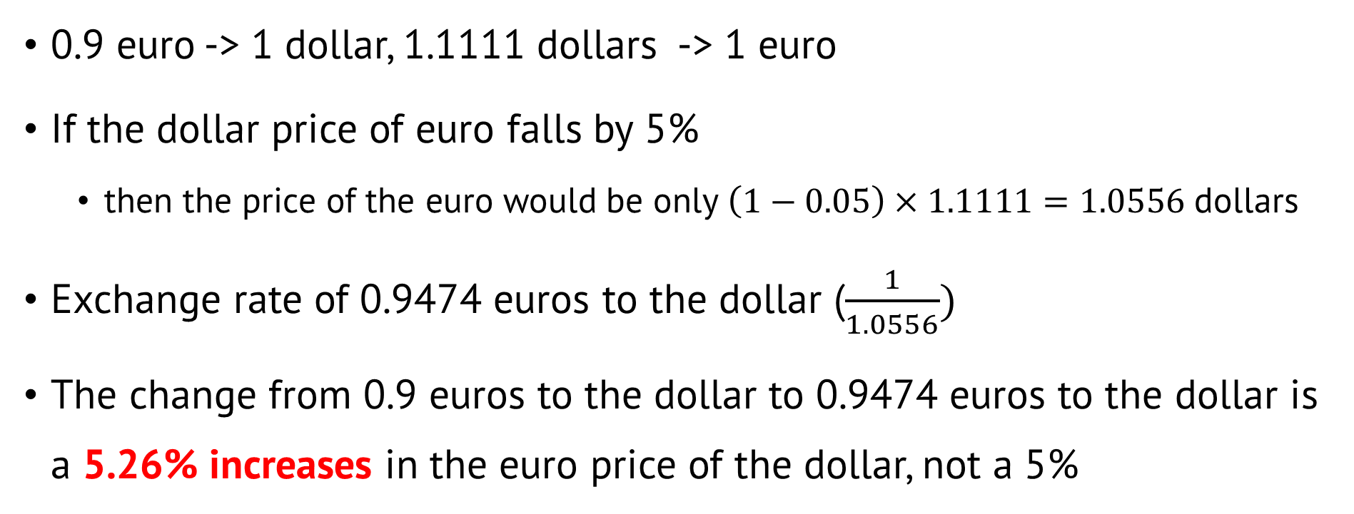
For example
0.9 euro -> 1 dollar, 1.1111 dollars -> 1 euro
If the dollar price of euro falls by 5%
then the price of the euro would be only $\left(1−0.05\right)×1.1111=1.0556$ dollars
Exchange rate of 0.9474 euros to the dollar ($\frac{1}{1.0556})$
The change from 0.9 euros to the dollar to 0.9474 euros to the dollar is a 5.26% increases in the euro price of the dollar, not a 5%
Notes:
歐元貶值5%，可以換得1.0556 dollars
X -> 1 dollar, 1.0556 -> 1 euro

Slide 4
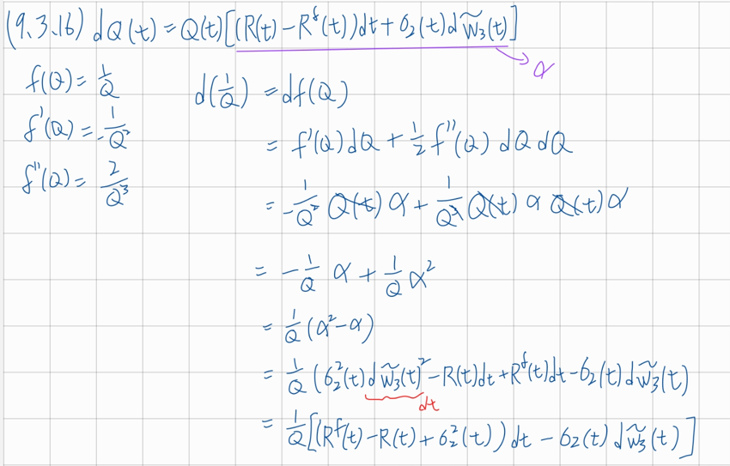

The convexity effect
Take $f\left(x\right)=\frac{1}{x} f^{′}\left(x\right)=−\frac{1}{x^{2}} f^{′′}\left(x\right)=\frac{2}{x^{3}}$
Using (9.3.16), we obtain
(9.3.24)

Slide 5
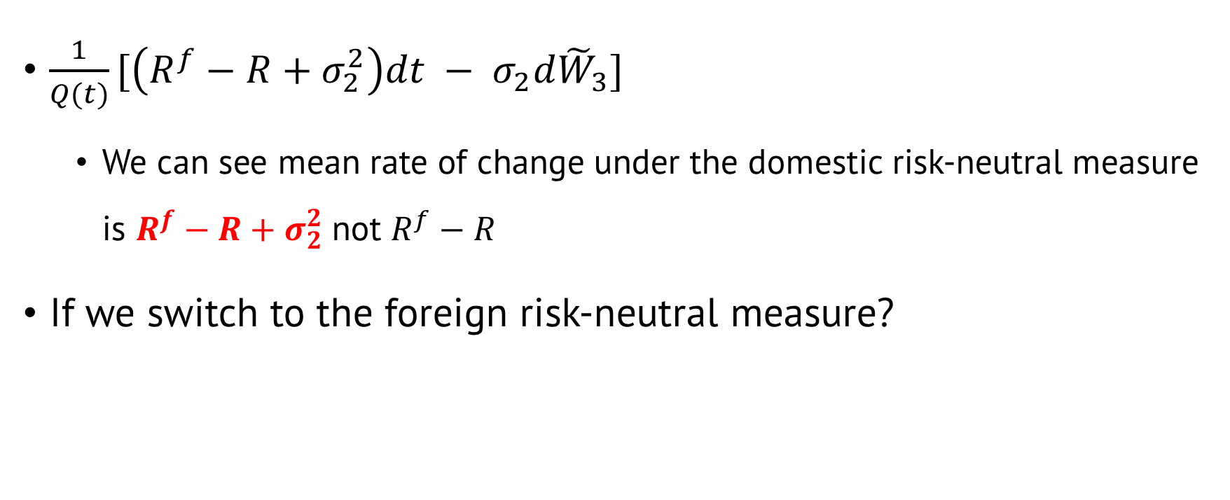
Analysis of equation 9.3.24
$\frac{1}{Q(t)}[\left(R^{f}−R+σ_{2}^{2}\right)dt − σ_{2}d{\tilde{W}}_{3}]$
We can see mean rate of change under the domestic risk-neutral measure is $R^{f}−R+σ_{2}^{2}$ not $R^{f}−R$
If we switch to the foreign risk-neutral measure?

Slide 6
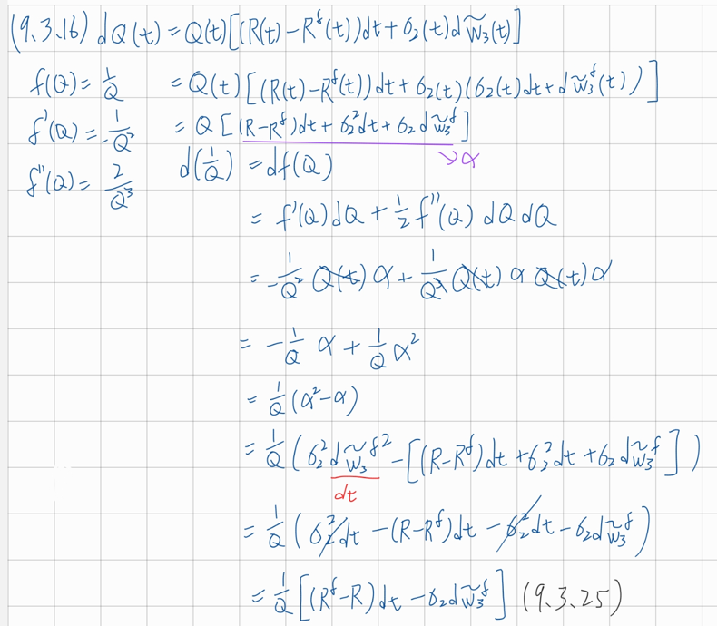
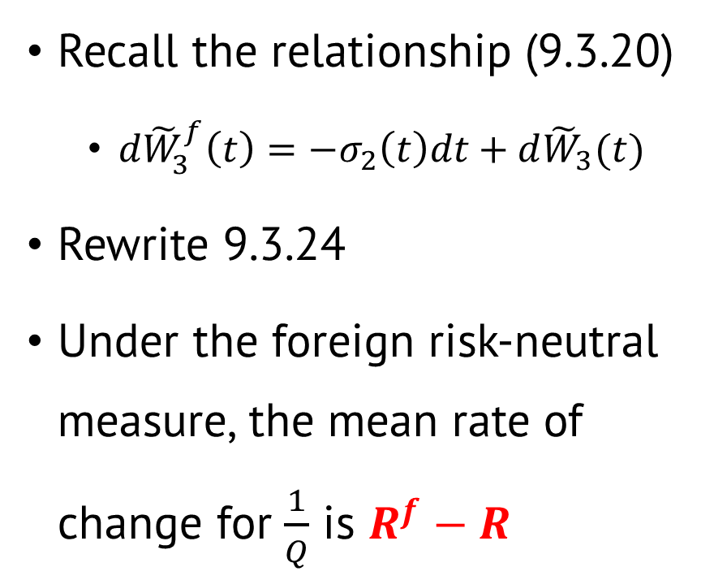
In foreign risk-neutral measure
Recall the relationship (9.3.20)
$d{\tilde{W}}_{3}^{f}\left(t\right)=−σ_{2}\left(t\right)dt+d{\tilde{W}}_{3}(t)$
Rewrite 9.3.24
Under the foreign risk-neutral measure, the mean rate of change for $\frac{1}{Q}$ is $R^{f}−R$

Slide 7
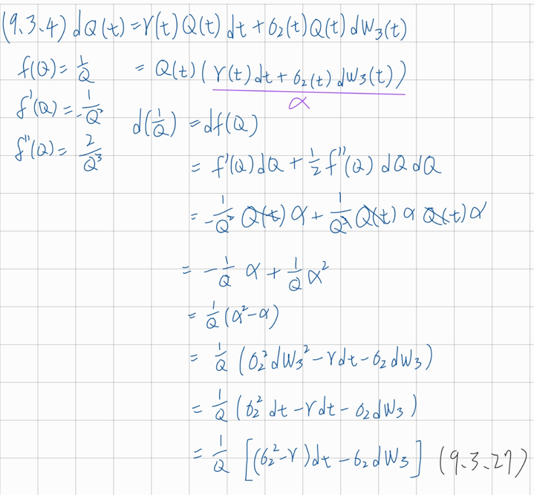

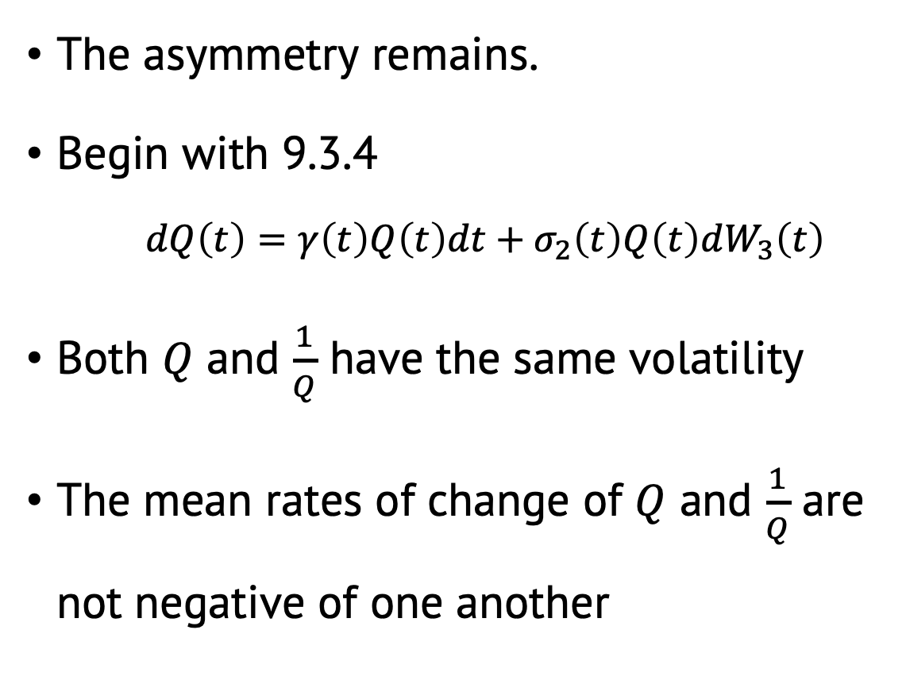
Under the actual probability measure $ℙ$
The asymmetry remains.
Begin with 9.3.4
$dQ\left(t\right)=γ\left(t\right)Q\left(t\right)dt+σ_{2}\left(t\right)Q\left(t\right)dW_{3}\left(t\right)$
Both $Q$ and $\frac{1}{Q}$ have the same volatility
The mean rates of change of $Q$ and $\frac{1}{Q}$ are not negative of one another
Notes:
Brownian motion是對稱的所以有沒有負號不影響

Slide 8
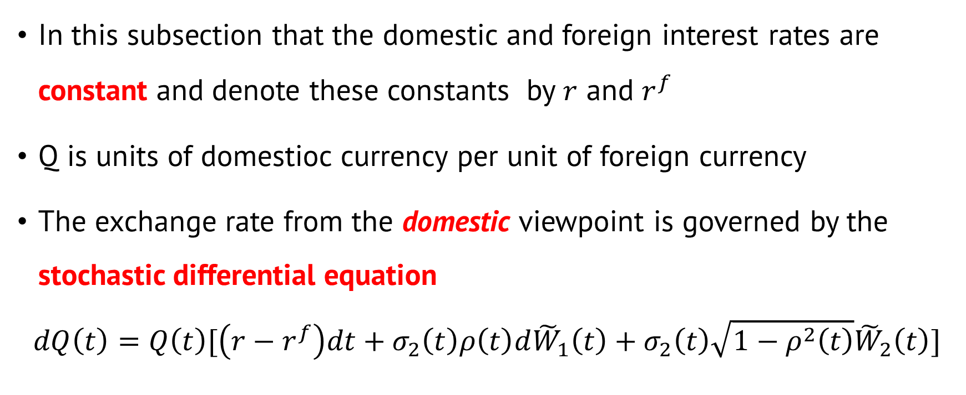
9.3.5 Forward Exchange Rates
In this subsection that the domestic and foreign interest rates are constant and denote these constants by $r$ and $r^{f}$
Q is units of domestioc currency per unit of foreign currency
The exchange rate from the domestic viewpoint is governed by the stochastic differential equation
$$dQ\left(t\right)=Q\left(t\right)[\left(r−r^{f}\right)dt+σ_{2}\left(t\right)ρ\left(t\right)d{\tilde{W}}_{1}\left(t\right)+σ_{2}\left(t\right)\sqrt{1−ρ^{2}\left(t\right)}{\tilde{W}}_{2}\left(t\right)]$$

Slide 9
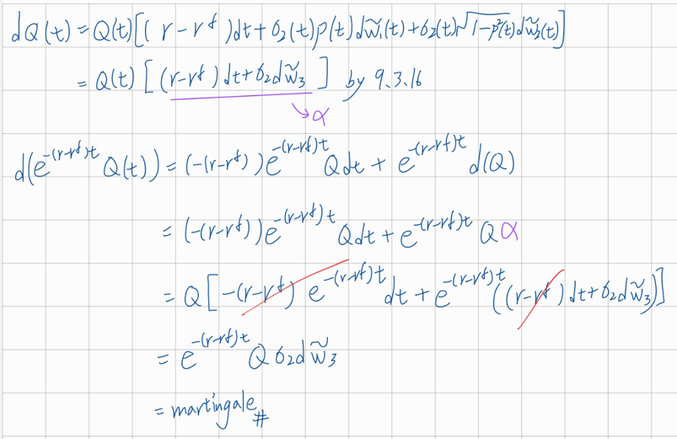
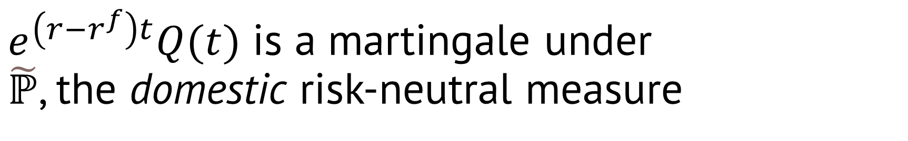
$e^{\left(r−r^{f}\right)t}Q(t)$ is a martingale under $\tilde{ℙ}$, the domestic risk-neutral measure

Slide 10
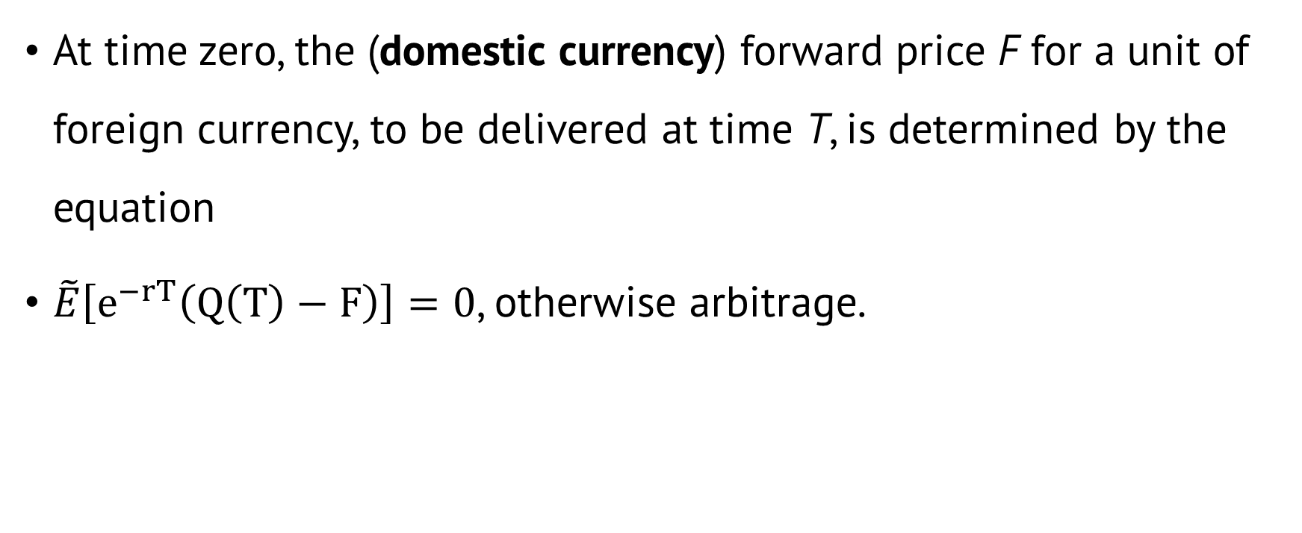
No arbitrage
At time zero, the (domestic currency) forward price F for a unit of foreign currency, to be delivered at time T, is determined by the equation
$\tilde{E}\left[e^{−rT}\left(Q\left(T\right)−F\right)\right]=0$, otherwise arbitrage.

Slide 11

Solve equation for F
$\tilde{E}\left[e^{−rT}\left(Q\left(T\right)−F\right)\right]$
$\tilde{E}\left[e^{−rT}Q(T)\right]=e^{−rT}F$
$e^{{−r}^{f}T}\tilde{E}\left[e^{−(r−r^{f})T}Q(T)\right]$
$e^{−r^{f}T}e^{−\left(r−r^{f}\right)0}Q\left(0\right)=e^{−r^{f}T}Q\left(0\right)$
$e^{−rT}F=e^{−r^{f}T}Q\left(0\right)$
$F=e^{\left(r−r^{f}\right)T}Q(0)$
In previous, we know this is a martingale.

Slide 12
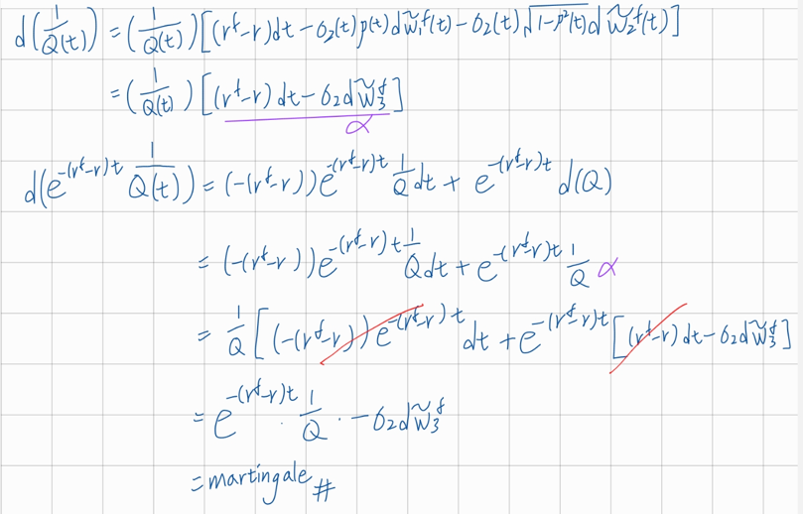

The exchange rate from the foreign viewpoint
$e^{−\left(r^{f}−r\right)t}\frac{1}{Q\left(t\right)}$ is a martingale under ${\tilde{ℙ}}^{f}$, the foreign risk-neutral measure

Slide 13
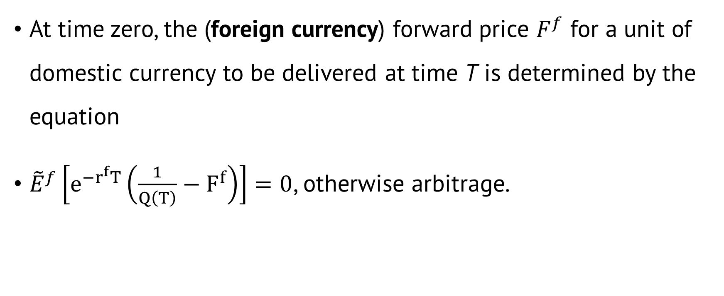
Again, No arbitrage
At time zero, the (foreign currency) forward price $F^{f}$ for a unit of domestic currency to be delivered at time T is determined by the equation
${\tilde{E}}^{f}\left[e^{−r^{f}T}\left(\frac{1}{Q\left(T\right)}−F^{f}\right)\right]=0$, otherwise arbitrage.

Slide 14


Solve equation for F
${\tilde{E}}^{f}\left[e^{−r^{f}T}\left(\frac{1}{Q\left(T\right)}−F^{f}\right)\right]$
${\tilde{E}}^{f}\left[e^{−r^{f}T}\frac{1}{Q\left(T\right)}\right]=e^{−r^{f}T}F^{f}$
$e^{−rT}{\tilde{E}}^{f}\left[e^{−(r^{f}−r)T}\frac{1}{Q\left(T\right)}\right]$
$e^{−rT}e^{−\left(r^{f}−r\right)0}\frac{1}{Q\left(0\right)}=e^{−rT}\frac{1}{Q\left(0\right)}$
$e^{−r^{f}T}F^{f}=e^{−rT}\frac{1}{Q\left(0\right)}$
$F^{f}=e^{\left(r^{f}−r\right)T}\frac{1}{Q\left(0\right)}=\frac{1}{F}$
In previous, we know this is a martingale.
$$F=e^{\left(r−r^{f}\right)T}Q(0)$$

